Slide 1
Capstone Project 2025 on
FinSim:
Market Trends, Investment Forecasting and Risk Forecasting
Presented by:-
Lachiket Warule
Aditi Sangle
Niyati Patil

Slide 2
What is FINSIM?
FINSIM is a comprehensive AI-based simulation platform designed to support data-driven investment decisions. This is a 3 part financial simulation system:
🕒 Market Scenario Analysis
✅ Investment Forecasting
⚠️ Risk Assessment
Each module in the system leverages its own set of algorithmic strategies tailored to its unique purpose. However, they all operate through a unified, streamlined data pipeline that ensures consistency and integration across the board.
We explore how the Market Scenario Analysis, Investment Forecasting, and Risk Assessment modules work together and more importantly, how they showcase the power of advanced sequence models, such as LSTMs and other deep learning techniques, in capturing and predicting complex stock price behaviors over time.

Slide 3
Why FINSIM?
Financial markets are complex and influenced by numerous factors: volatility, investor sentiment, technical patterns, and macroeconomic events.
Retail and institutional investors often ask:
What will happen to this stock in the coming weeks?
Is the market trending upward or crashing?
How risky is it to invest now?
FINSIM tackles these critical financial questions by applying machine learning algorithms built on strong foundations in computational theory.
It enables us to not only predict future stock prices with greater accuracy, but also analyze evolving market scenarios and assess potential investment risks. By doing so, FINSIM equips investors with reliable, model-driven insights that enhance decision-making and reduce uncertainty in complex financial environments.

Slide 4
Algorithms Behind FINSIM
Market Scenario Detection: LSTM helps users understand market trends and sets the stage for forecasting and risk-based decision-making. Ability to capture temporal dependencies in stock prices.
Investment Forecasting: At the heart of this module is the LSTM (Long Short-Term Memory) neural network — a deep learning architecture well-suited for capturing patterns in time-series data. It's trained to recognize historical trends in stock prices and generate accurate future price forecasts across different market conditions.
Risk Assessment: Heuristic + statistical logic based on drawdown and volatility VAR, Sharpe Ratio, Time-series forecasting Rolling Mean Forcast (30D)
Across all modules, we leverage common techniques such as sliding window processing, temporal data sequencing, state-based logic, and supervised learning to ensure consistency and contextual accuracy.
All models are trained individually for each ticker and seamlessly integrated into a unified Streamlit interface, allowing users to interactively explore predictions, market classifications, and risk profiles — all in real time.

Slide 5
Dataset Summary
15 years of historical data (2009 to 2024) for 40 companies
165,000 total row processed
Columns include:
Price metrics (Open, High, Low, Close), technical indicators (RSI, MACD, Bollinger Bands), sentiment scores, momentum
Data was cleaned, scaled per ticker, and structured using time-series techniques for model input
Ensured no missing values or outliers disrupted LSTM learning

Slide 6
Architecture & Data Pipeline
Data Flow:
Stock data from 40 tickers (2009–2024)
Preprocessing: Cleaning, sorting, scaling, feature selection
Model training loop:
For each ticker → train LSTM → evaluate → save model
Forecasting pipeline includes:
LSTM prediction → risk analysis (via volatility metrics) → scenario classification (via trend direction)
All integrated into a Streamlit UI where predictions are interactive and downloadable

Slide 7
Part 1 :- Market Scenario Analysis
🎯 Objective:
To analyze and predict market behavior based on historical data using deep learning, specifically focusing on Long Short-Term Memory (LSTM) networks. This module helps users understand market trends and sets the stage for forecasting and risk-based decision-making.
📈 Workflow Overview:
Data Collection & Preprocessing:
Financial time series data (e.g., stock prices) is retrieved using the Yahoo Finance API (yfinance library).
Key features include: Open, High, Low, Close, and Volume.
Data is cleaned by:
Handling missing values
Formatting dates
Normalizing features (e.g., using MinMaxScaler)

Slide 8
📈 Model Pipeline:
Input: Historical stock prices — usually the ‘Close’ price is used.
A sliding window approach is used to create training samples.
E.g., if the window size is 60, each input sequence contains 60 days of past prices to predict the 61st day.
Data is scaled using MinMaxScaler to normalize the range to [0, 1] for stable training.
LSTM Architecture:
Input Layer: 3D array (samples, timesteps, features)
LSTM Layers: One or more layers of LSTM units with memory cells to capture temporal dynamics.
Dense Output Layer: Produces the predicted price for the next time step.
Loss Function: Typically uses Mean Squared Error (MSE)
Optimizer: Usually Adam for efficient convergence
3. Training & Evaluation:
Model is trained on historical data split into training and validation sets.
Once trained, the model can:
Predict the next price point
Generate multi-step forecasts by feeding predictions back into the model iteratively
Accuracy is evaluated using metrics like:
Root Mean Squared Error (RMSE)
Mean Absolute Error (MAE)
Visual comparison of actual vs. predicted price curves

Slide 9
📈 LSTM Model – Core Algorithm:
LSTM (Long Short-Term Memory) networks are a type of Recurrent Neural Network (RNN) designed for time series and sequential data.
Key reasons for using LSTM:
Ability to capture temporal dependencies in stock prices
Memory cells that retain relevant past information and discard noise
📈 Model Details:
Input: Sequences of past n-days’ prices
Output: Predicted stock price for the next day(s)
Architecture: 1–2 LSTM layers with dropout, followed by Dense output layer
Loss Function: Mean Squared Error (MSE)
Optimizer: Adam

Slide 10
Reproducibility:
predictions vary slightly across runs.
Reason: Random seeds not fixed; model predictions may involve randomness in Keras backend.
Complexity:
Constant-time predictions — model inference time remains stable regardless of stock or data volume.
Suitable for batch processing.
Invariants Maintained:
Input format is preserved; 60-timestep sequence correctly reshaped before prediction.
No index errors or malformed inputs during batch predictions.

Slide 11
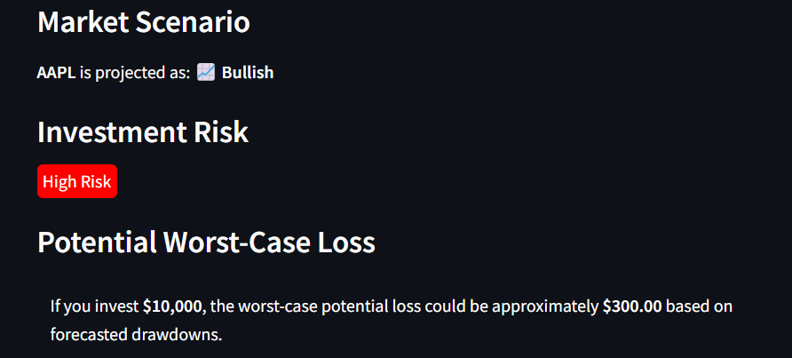
Reliability:
Moderate — needs improvement in reproducibility for extensive research
Suggest fixing seeds (np.random.seed(), tf.random.set_seed()).
Robustness:
High — model handles multiple stocks well.
Graceful error handling with try-except ensures the pipeline doesn’t break even if one prediction fails.
Scalability:
Efficient for multiple stocks — fast runtime and low overhead.

Slide 12
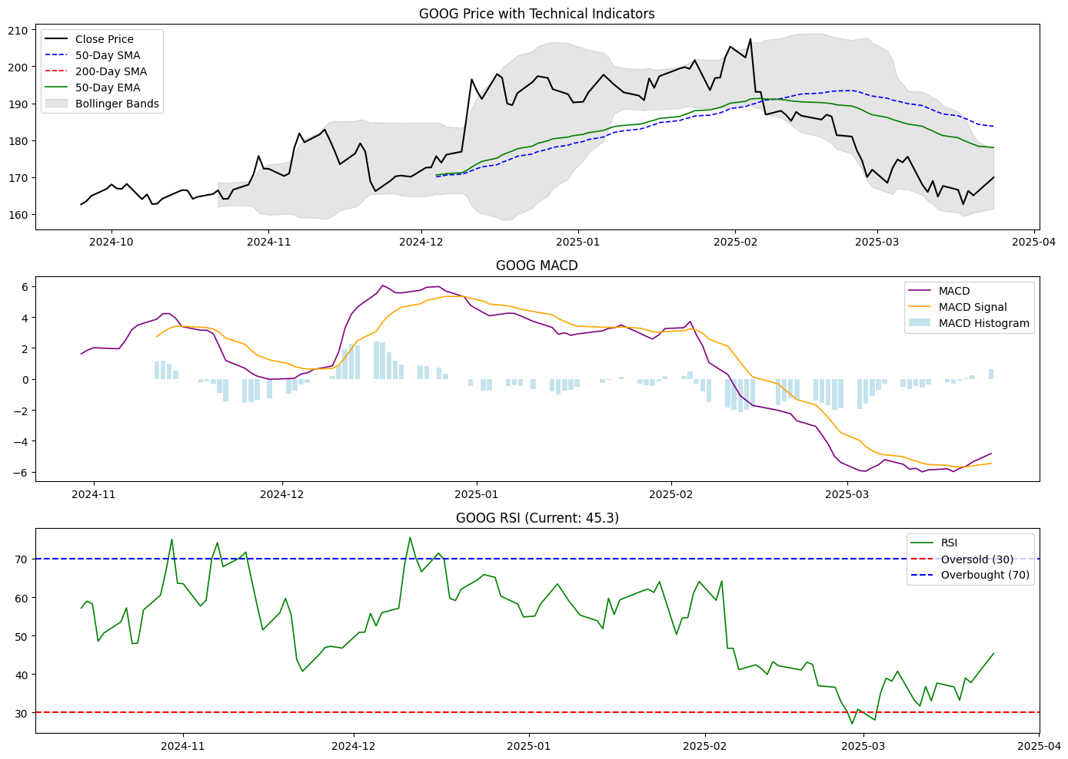
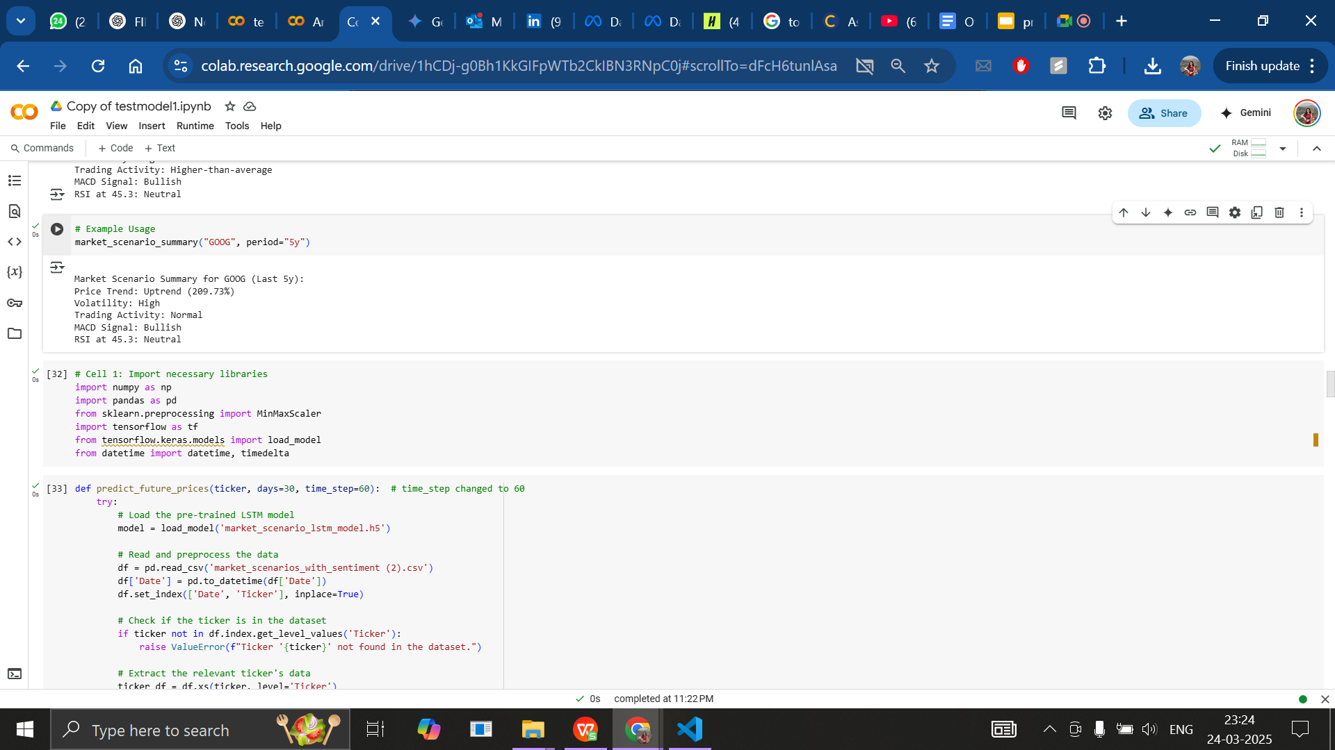

Slide 13
Part 2:- Investment Forecasting – LSTM Model Architecture
Forecasting Objective & Model Architecture:-
🎯 Goal: Predict the next 5 or 200 days of stock prices for each selected ticker, enabling investors to anticipate short-term and long-term trends and optimize entry/exit strategies.
🧠 Model Architecture:
2-layer LSTM (Long Short-Term Memory) neural network
Captures long-range temporal dependencies in sequential stock data
Dropout layers added for regularization
Dense output layer for multi-step prediction (5-day forecast)
📁 Output:
Forecasts generated per ticker
Models saved as .h5 files in the /saved_models/ directory for reuse

Slide 14
Input Features & Data Engineering
Features Used (Total: 8):
Close_Price – daily closing price
Volume – trading volume
RSI – Relative Strength Index
MACD and MACD_Signal – trend-following momentum indicators
ATR_14 – Average True Range (volatility)
Sentiment_Score – market sentiment from news/social sources
Price_Momentum – directional price movement
⚙️ Data Engineering Pipeline:
Sliding Window:
60-day historical window (look_back = 60) used for sequence input
Scaling:
Applied MinMaxScaler to normalize feature values per ticker
Target Output:
Predicts a sequence of 1-200 future closing prices

Slide 15
Sequence Learning with LSTM – From Theory to Practice
🧠 Why LSTM? Long Short-Term Memory (LSTM) networks are a specialized type of recurrent neural network (RNN) designed for sequence modeling — ideal for time-series data like stock prices.
🛠 Solving Standard RNN Limitations:
Memory cells retain important historical information across time steps
Input, output, and forget gates control the flow of information
Prevents vanishing gradient problems common in traditional RNNs
📚 Computation Theory Perspective:
Models state transitions — e.g., how price moves from one day to the next
Learns to retain relevant patterns (e.g., momentum, volatility) while filtering out noise
Uses Backpropagation Through Time (BPTT) to optimize weights across the full sequence

Slide 16
Applying LSTM to Financial Time Series Forecasting
📈 Use Case: Multi-Day Stock Price Forecasting
Our LSTM model transforms raw financial time series into a learned function capable of forecasting future price movements.
🔄 What the Model Learns:
Temporal dependencies between technical indicators and price behavior
Relationships between market momentum, volume, sentiment, and price outcomes
🔍 Input-Output Mapping Example:
Input: Past 60 days of features (e.g., Close Price, RSI, MACD)
Output: Predicted stock prices for the next 5 days
✅ Outcome: The model captures price dynamics over time, allowing us to forecast short-term trends — a key advantage in volatile and fast-moving markets.

Slide 17
Model Integration & Reusability
🔁 Model Deployment Strategy:
Trained models are saved individually per ticker
Integrated into a Streamlit dashboard for real-time forecasting
Allows users to select tickers and view 5-day predictions instantly
✅ Benefits:
Modular training & easy retraining per stock
Fast, scalable inference in production environments
Intuitive user experience with visual insights

Slide 18
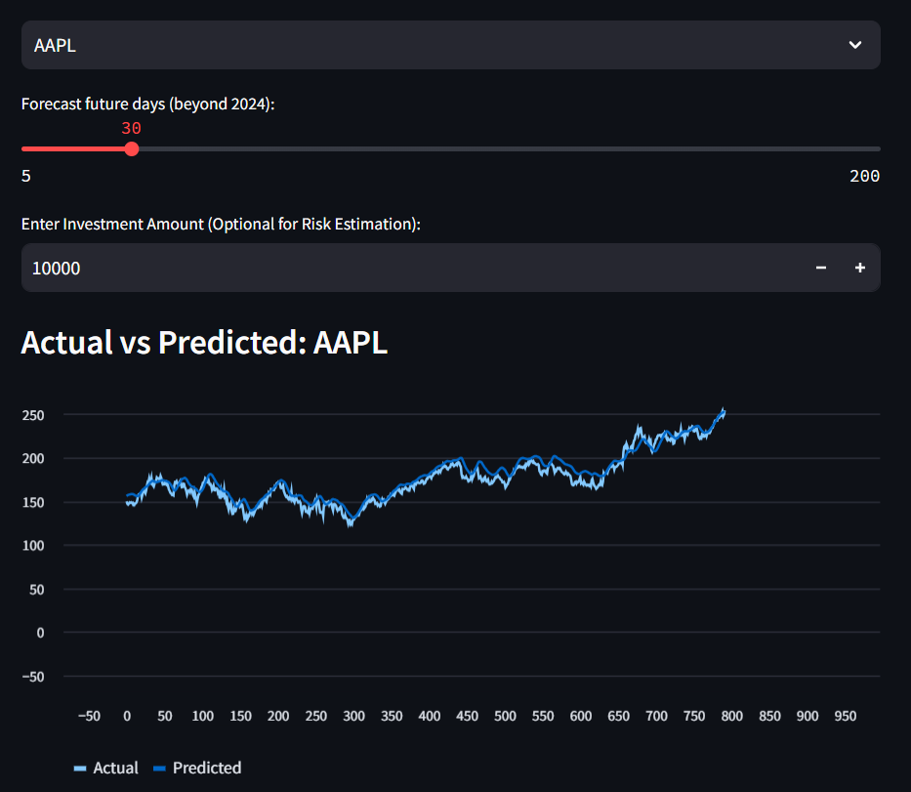
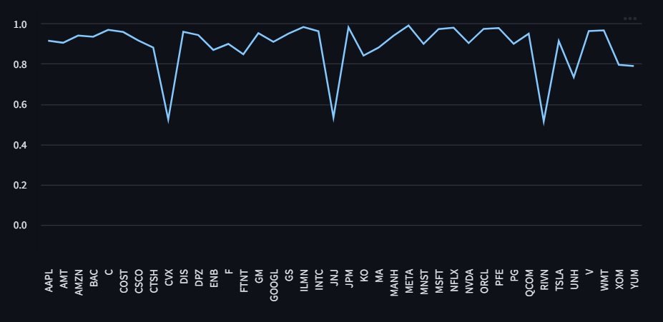
Part 2: Investment Forecasting

Slide 19
Part 3: Risk Assessment
A volatility-driven financial risk analysis system using historical stock data and predictive metrics to determine investment safety. FinSim focuses on robust financial risk assessment using proven statistical techniques and time-series analysis, rather than black-box ML models.
Objective
To evaluate the investment risk of major publicly traded companies using:
Adjusted close price data
Volatility indicators
Value at Risk (VaR), CVaR
Sharpe Ratio
Short-term forecasting
Help investors make informed, risk-aware decisions in real time.

Slide 20
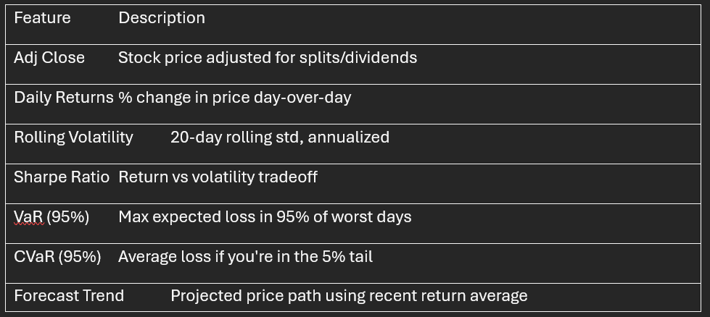
Model Architecture:
Volatility Modeling: Rolling STD (20D)
Risk Modeling: VaR, CVaR
Performance Analysis: Sharpe Ratio
Trend Projection: 30-day Forecast (return-based)
Deployment: Streamlit interactive dashboard
Features Used:

Slide 21
Benefits & Future Scope
Benefits:
Real-time analysis of investment risk
Transparent model logic (Sharpe, VaR)
Easy detection of high-risk stocks
Deployable via lightweight app
Future Scope:
Add FinBERT-based sentiment analysis
Integrate macroeconomic indicators (GDP, interest rates)
Package as a public dashboard or trading assistant

Slide 22
Challenges Faced
Multi-index data required careful reshaping
Small gaps in ticker price history caused NaNs in calculations
Sentiment API (NewsAPI / Twitter) access was denied or limited:
403 / 426 errors
Free tier restrictions
Limited historical coverage
Decision: Removed sentiment to maintain project stability and focused on quantitative risk metrics.
Conclusion
FinSim demonstrates how financial risk can be quantified and visualized clearly using volatility, VaR, and performance indicators.
The project lays a strong foundation for future AI-driven financial decision-making systems.

Slide 23
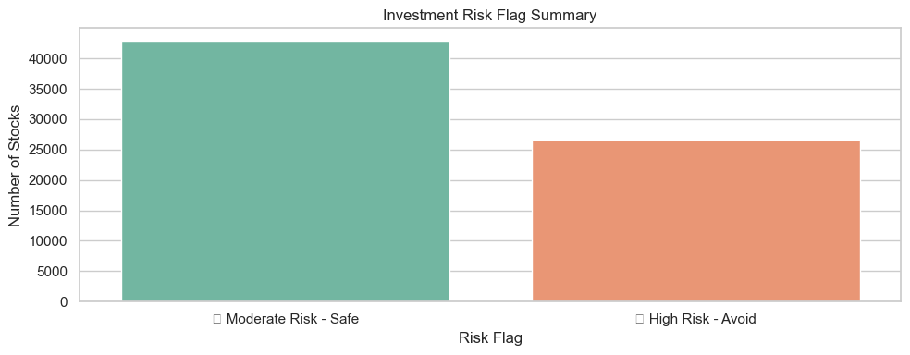
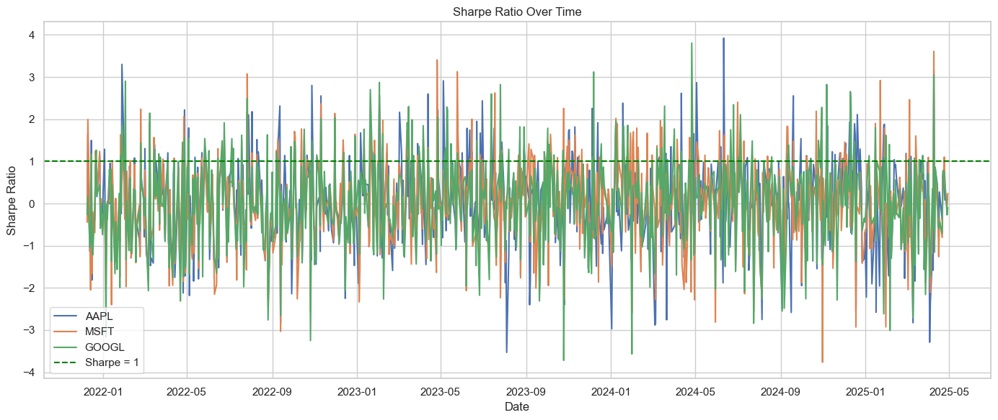

Slide 24
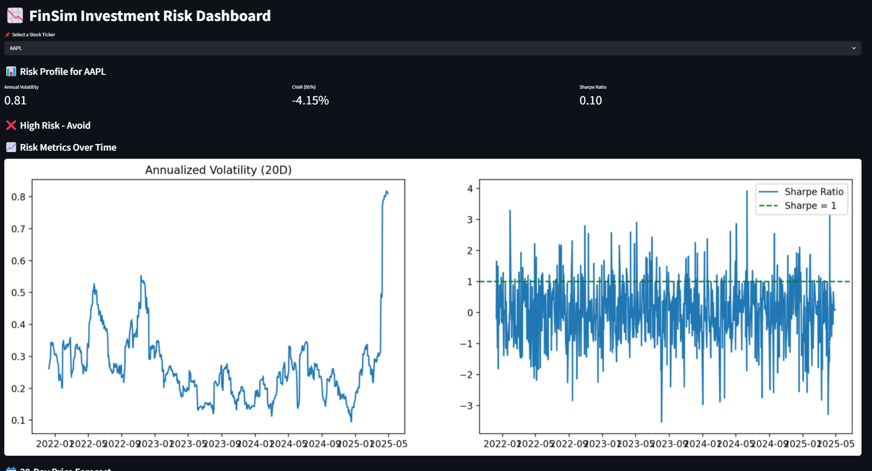

Slide 25
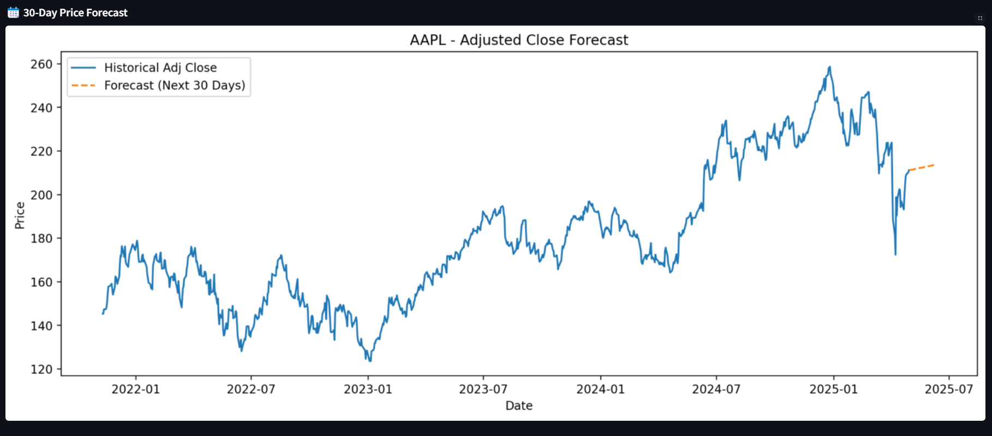

Slide 26
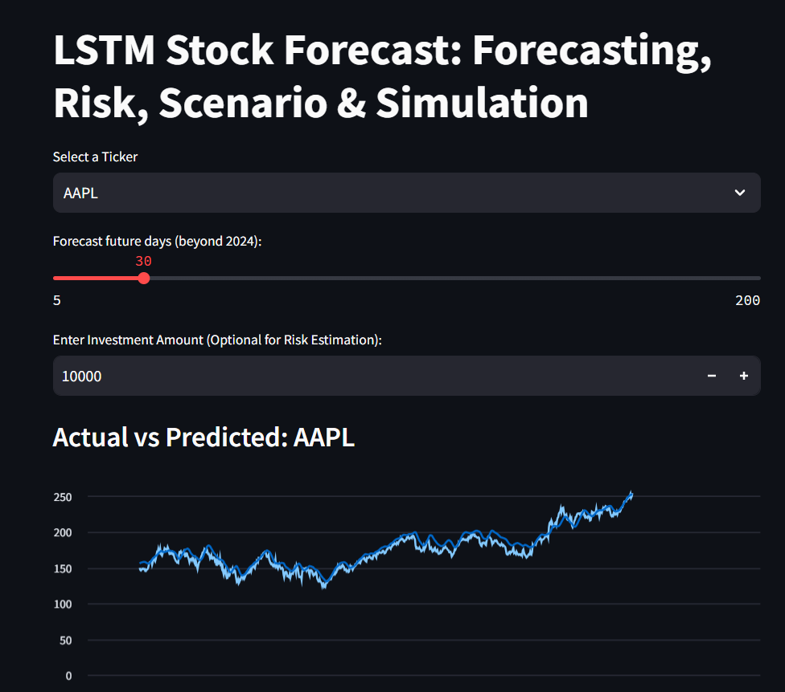
Streamlit Forecasting Module
User selects a ticker → model loads from disk
User chooses forecast duration (5–200 days)
Streamlit displays:
Actual vs Predicted (line chart)
Combined historical + future prices (Altair chart)
Insight Summary (NLP-based message generation)
Fully interactive + includes download buttons for forecast CSV and evaluation reports

Slide 27
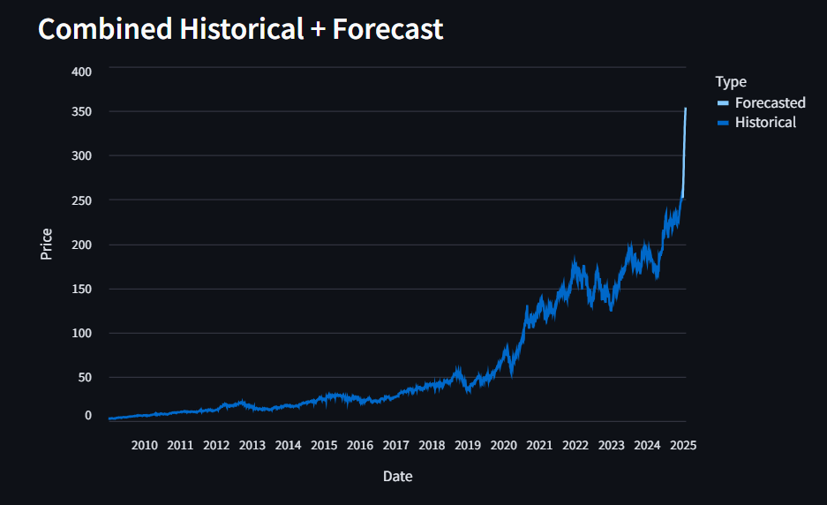
Forecast Output & Simulation
Forecast shows predicted future trend alongside real historical prices
Scenario simulation allows user to simulate a drop (e.g., -10%) and see effect on potential loss
Combined with:
Market Scenario label (e.g., 📈 Bullish or 📉 Bearish)
Risk Level badge (e.g., 🔴 High Risk or 🟢 Low Risk)
This holistic output helps users make informed and confident decisions

Slide 28
Future Scope
Expand to portfolio-level forecasting
Build mobile-friendly version of the tool
Improve insight generation using advanced NLP

Slide 29
📈 Challenges
During this project, one of the major challenges was handling a 15-year historical dataset, which presented numerous data quality and consistency issues. Over such a long period, there were missing values, outliers from market shocks, and inconsistencies due to changes in reporting standards, stock splits, and other corporate actions.
These issues made it difficult to ensure the dataset was accurate and comparable across the years. Additionally, the volatility and external events, such as financial crises, added complexity to modeling market conditions.
Overcoming these challenges required extensive data cleaning, imputation of missing values, outlier detection, and normalization to ensure the data was consistent and reliable for predictive modeling.

Slide 30
Thank You

